Slide 1


Raspberry Pi 3
H. Melih Erdogan
Lab Assistant
Intelligent Robotics I - ECE 478/578
Electrical and Computer Engineering Department Maseeh
College of Engineering and Computer Science

Slide 2
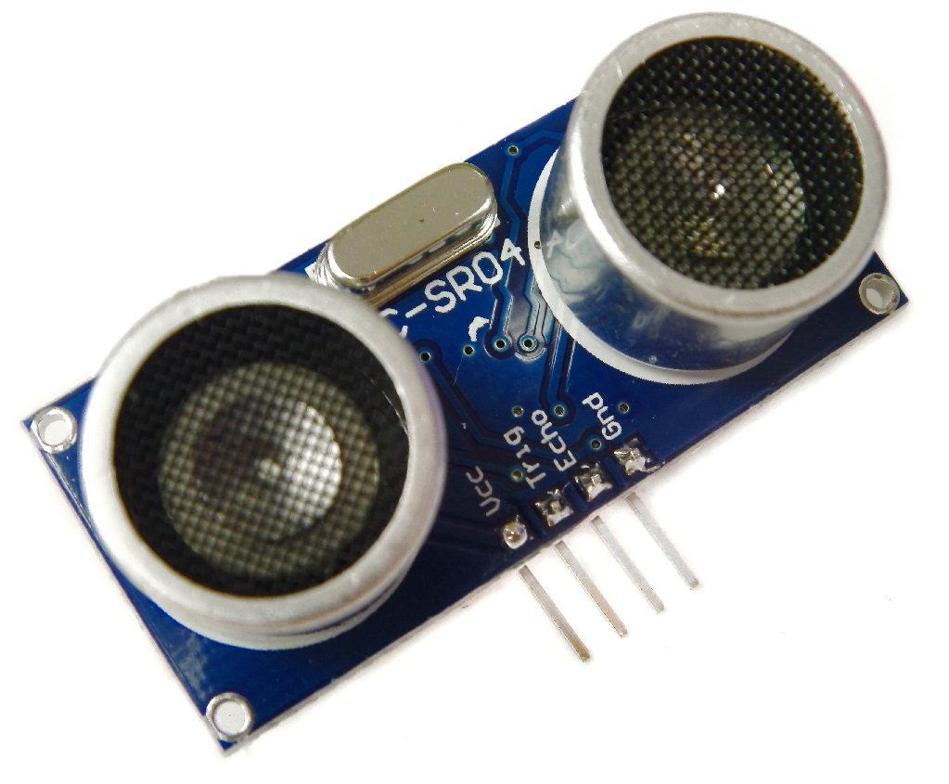
Ultrasonic Sound Sensors
Ultrasonic sensors are designed to sense object proximity or range using ultrasound reflection, similar to radar, to calculate the time it takes to reflect ultrasound waves between the sensor and a solid object. Ultrasound is mainly used because it’s inaudible to the human ear and is relatively accurate within short distances.
Only some of the sound spectrum (the range of sound wave frequencies) is audible to the human ear, defined as the “Acoustic” range. Very low frequency sound below Acoustic is defined as “Infrasound”, with high frequency sounds above, called “Ultrasound”.

Slide 3

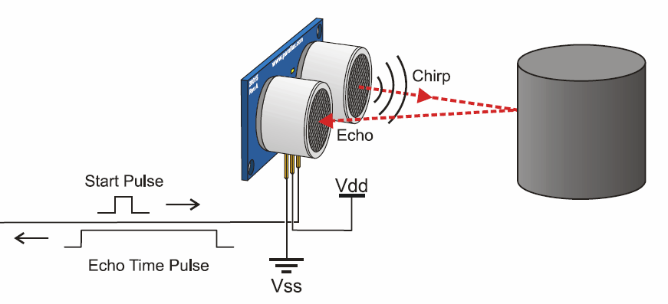
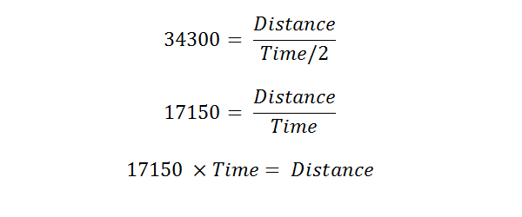
How does it work?

Slide 4
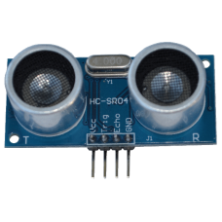
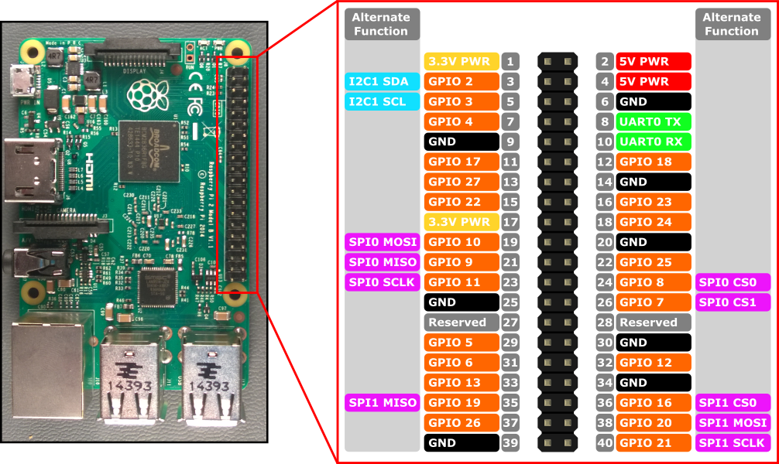
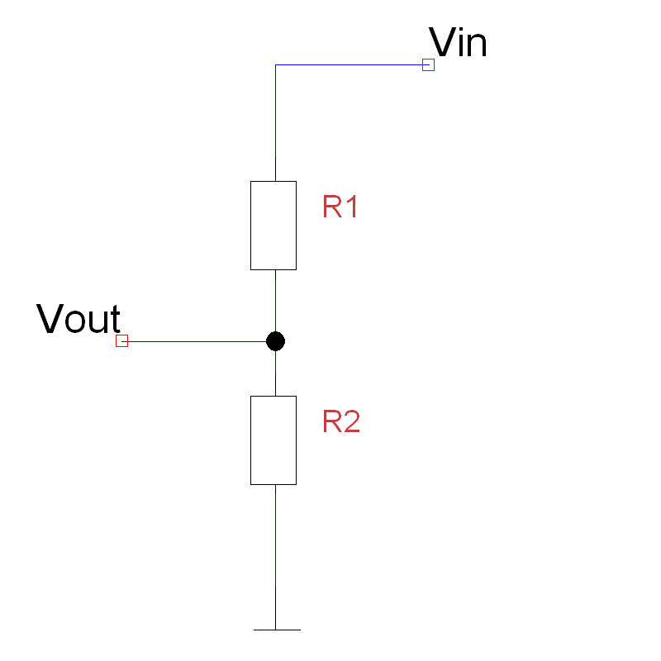

Slide 5
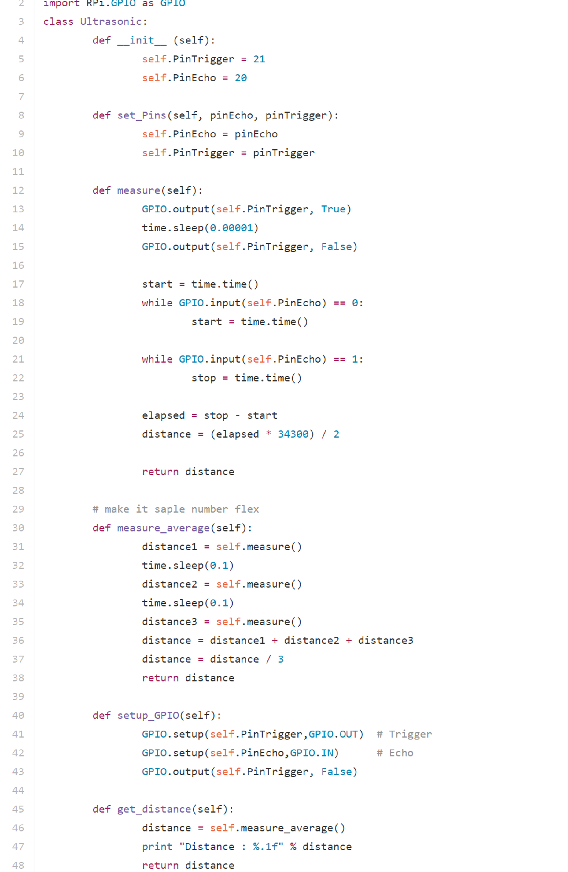

Slide 6
Code
https://github.com/mlherd/vikingbot/

Slide 7
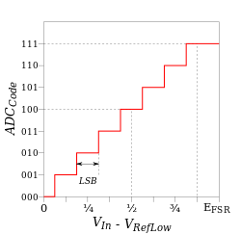
ADC
Analog to Digital Converter
The Raspberry Pi computer does not have a way to read analog inputs. It's a digital-only computer.
Therefore, we can’t use analog sensors or devices with our Raspberry Pi. We need an additional hardware to read analog inputs.

Slide 8
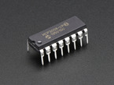
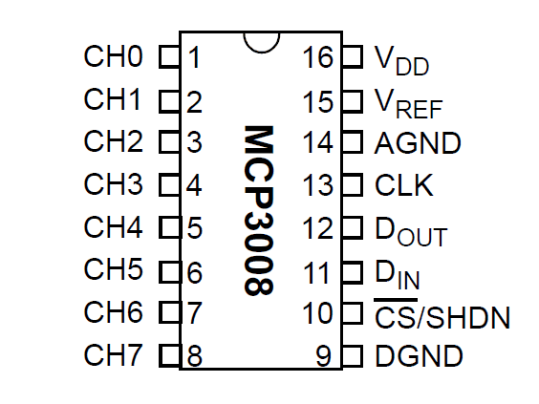
MCP3008
This chip adds 8 channels of 10-bit analog input to our Raspberry Pi boards.
It uses SPI interface

Slide 9
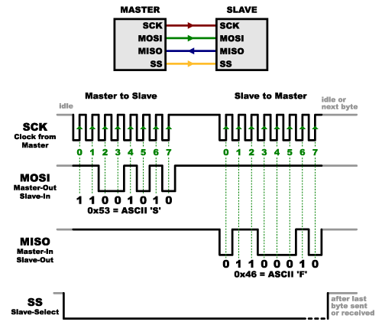
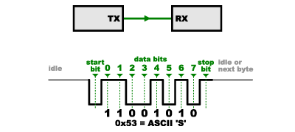
SPI - Serial Peripheral Interface
- Serial Peripheral Interface (SPI) is an interface bus commonly used to send data between microcontrollers and small peripherals such as shift registers, sensors, and SD cards. It uses separate clock and data lines, along with a select line to choose the device you wish to talk to.
- Unlike UART , It is a synchronous solution to send and receive data from devices.

